Slide 1
Counting by Mapping
A
B
…
f
…

Slide 2
This Lecture
We will study how to define mappings to count.
There will be many examples shown.
Bijection rule
Division rule
More mapping

Slide 3
Counting Rule: Bijection
If f is a bijection from A to B,
then |A| = |B|
A
B
…
f
…
To compute |A|, one strategy is to define a bijection of A and B,
where B is easier to count and we can compute |B| directly.

Slide 4
Power Set
How many subsets of a set S?
P(S) = the power set of S
= the set of all subsets of S
for S = {a, b, c},
P(S) = {∅, {a}, {b}, {c}, {a,b}, {a,c}, {b,c}, {a,b,c} }
Suppose S has n elements.
How large is the power set of S?

Slide 5
Bijection: Power Set and Binary Strings
S : {s₁, s₂, s₃, s₄, s₅, … , s_{n}}
We define a bijection between subsets and binary strings
A: the set of all subsets of S
B: the set of all binary strings of length n
A
B
…
…
f
The mapping is defined in the following way:
subset: {s₁, s₃, s₄, … , s_{n}}
string: 1 0 1 1 0 … 1

Slide 6
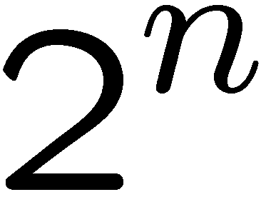
Bijection: Power Set and Binary Strings
The mapping is defined in the following way:
subset: {s₁, s₃, s₄, … , s_{n}}
A
B
…
…
string: 1 0 1 1 0 … 1
f
This mapping is a bijection, because
two different subsets are mapped to two different strings (injection)
each binary string represents some subset (surjection).
Therefore, |A| = |B|, and |B| can be computed directly.
So, |n-bit binary strings| = |P(S)|

Slide 7
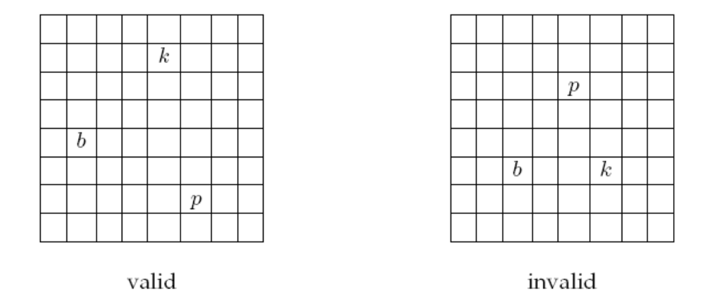
A Chess Problem
In how many different ways can we place a pawn (p),
a knight (k), and a bishop (b) on a chessboard so that
no two pieces share a row or a column?

Slide 8
A Chess Problem
We define a mapping between configurations to
sequences (r(p), c(p), r(k), c(k), r(b), c(b)),
where r(p), r(k), and r(b) are distinct rows,
and c(p), c(k), and c(b) are distinct columns.
A: the set of the configurations of the 3 pieces
B: the set of the such sequences of 6 numbers
A
B
…
…
f
If we can define a bijection between A and B,
and also calculate |B|, then we can determine |A|.

Slide 9
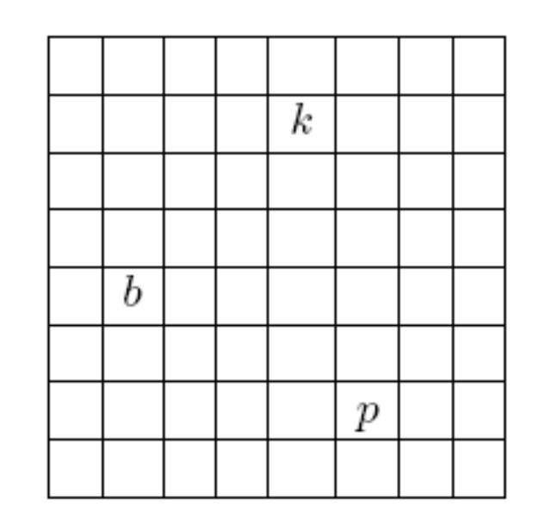
A Chess Problem
We define a mapping between configurations to
sequences (r(p), c(p), r(k), c(k), r(b), c(b)),
where r(p), r(k), and r(b) are distinct rows,
and c(p), c(k), and c(b) are distinct columns.
(7,6,2,5,5,2)
(2,5)
This is a bijection, because:
it is an injection
it is a surjection
(5,2)
So, to count the number of chess configurations,
it is equivalent to count the number of such sequences.
(7,6)

Slide 10
A Chess Problem
We define a mapping between configurations to
sequences (r(p), c(p), r(k), c(k), r(b), c(b)),
where r(p), r(k), and r(b) are distinct rows,
and c(p), c(k), and c(b) are distinct columns.
Using the generalized product rule,
there are 8 choices of r(p) and c(p),
there are 7 choices of r(k) and c(k),
there are 6 choices of r(b) and c(b).
Thus, total number of configurations
= (8x7x6)² = 112896.
(7,6,2,5,5,2)

Slide 11

Counting Doughnut Selections
There are five kinds of doughnuts.
How many different ways to select a dozen doughnuts?
00 (none) 000000 00 00
Chocolate Lemon Sugar Glazed Plain
A ::= all selections of a dozen doughnuts
Hint: define a bijection!
A
B
…
…
f

Slide 12
Counting Doughnut Selections
A ::= all selections of a dozen doughnuts
B::= all 16-bit binary strings with exactly four 1’s.
Define a bijection between A and B.
0011000000100100
00 1 1 000000 1 00 1 00
00 (none) 000000 00 00
Chocolate Lemon Sugar Glazed Plain
Each doughnut is represented by a 0,
and four 1’s are used to separate five types of doughnuts.

Slide 13
Counting Doughnut Selections
A ::= doughnuts selections
B::= all 16-bit strings with four 1’s.
12 0 0 0 0
Chocolate Lemon Sugar Glazed Plain
0000000000001111
2 3 0 3 4
Chocolate Lemon Sugar Glazed Plain
0010001100010000
2 0 6 2 2
Chocolate Lemon Sugar Glazed Plain
0011000000100100
0 0 0 0 12
Chocolate Lemon Sugar Glazed Plain
1111000000000000

Slide 14
Counting Doughnut Selections
c chocolate, l lemon, s sugar, g glazed, p plain maps to
0^{c}10^{l}10^{s}10^{g}10^{p}
A ::= all selections of a dozen doughnuts
B::= all 16-bit binary strings with exactly four 1’s.
This is a bijection because
Two doughnut selections map to two different strings. (injection)
(think of a doughnut selection as a sequence of 5 numbers (c,l,s,g,p),
consider the first number which is different in the two sequences).
Every string in B corresponds to a valid doughnut selection. (surjection)

Slide 15
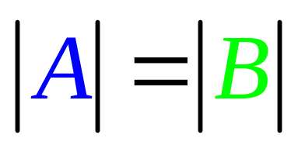
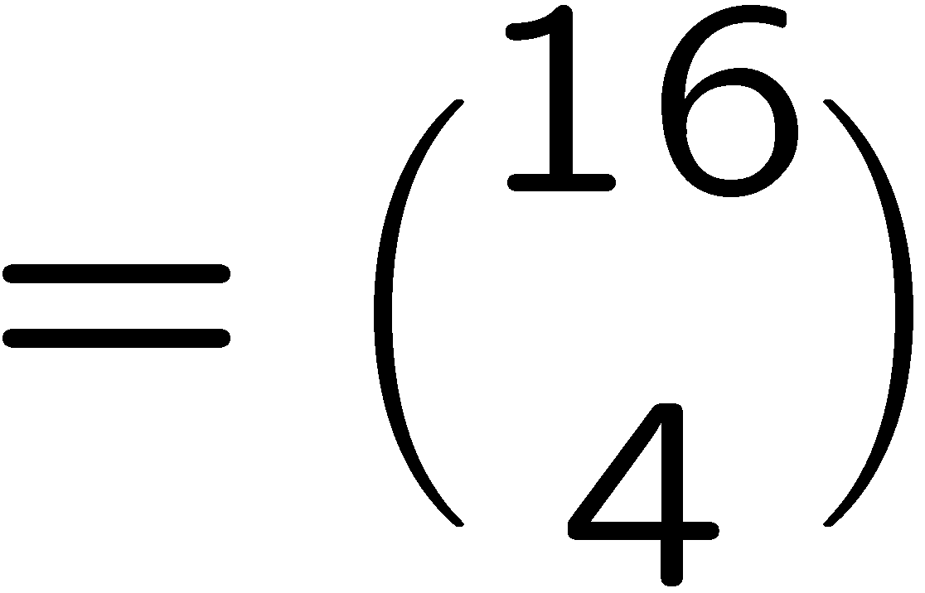
Counting Doughnut Selections
c chocolate, l lemon, s sugar, g glazed, p plain
maps to
a bijection
0^{c}10^{l}10^{s}10^{g}10^{p}
A ::= all selections of a dozen doughnuts
B::= all 16-bit binary strings with exactly four 1’s.

Slide 16
Choosing Non-Adjacent Books
There are 20 books arranged in a row on a shelf.
How many ways to choose 6 of these books so that
no two adjacent books are selected?
A ::= all selections of 6 non-adjacent books from 20 books
Hint: define a bijection!
A
B
…
…
f

Slide 17
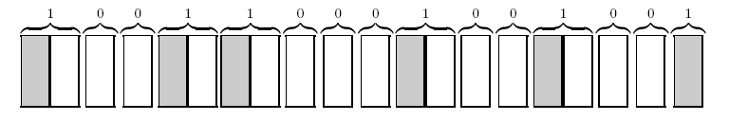
Choosing Non-Adjacent Books
A ::= all selections of 6 non-adjacent books from 20 books
B::= all 15-bit binary strings with exactly six 1’s.
Map each zero to a non-chosen book, each of the first five 1’s to a chosen
book followed by a non-chosen book, and the last 1 to a chosen book.
This is a bijection, because:
it is an injection
it is a surjection

Slide 18
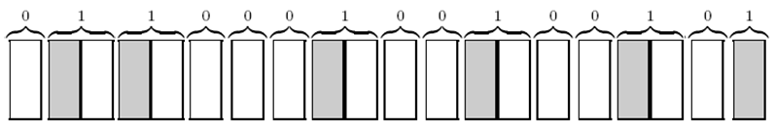
00 | 01 | 02 | 03 | 04 | 05 | 06 | 07 | 08 | 09 | 10 | 11 | 12 | 13 | 14
1 | 0 | 0 | 1 | 1 | 0 | 0 | 0 | 1 | 0 | 0 | 1 | 0 | 0 | 1
1
2
3
4
5
6
7
8
9
10
11
12
13
14
15
16
17
18
19
20
00 | 01 | 02 | 03 | 04 | 05 | 06 | 07 | 08 | 09 | 10 | 11 | 12 | 13 | 14
0 | 1 | 1 | 0 | 0 | 0 | 1 | 0 | 0 | 1 | 0 | 0 | 1 | 0 | 1
1
2
3
4
5
6
7
8
9
10
11
12
13
14
15
16
17
18
19
20

Slide 19
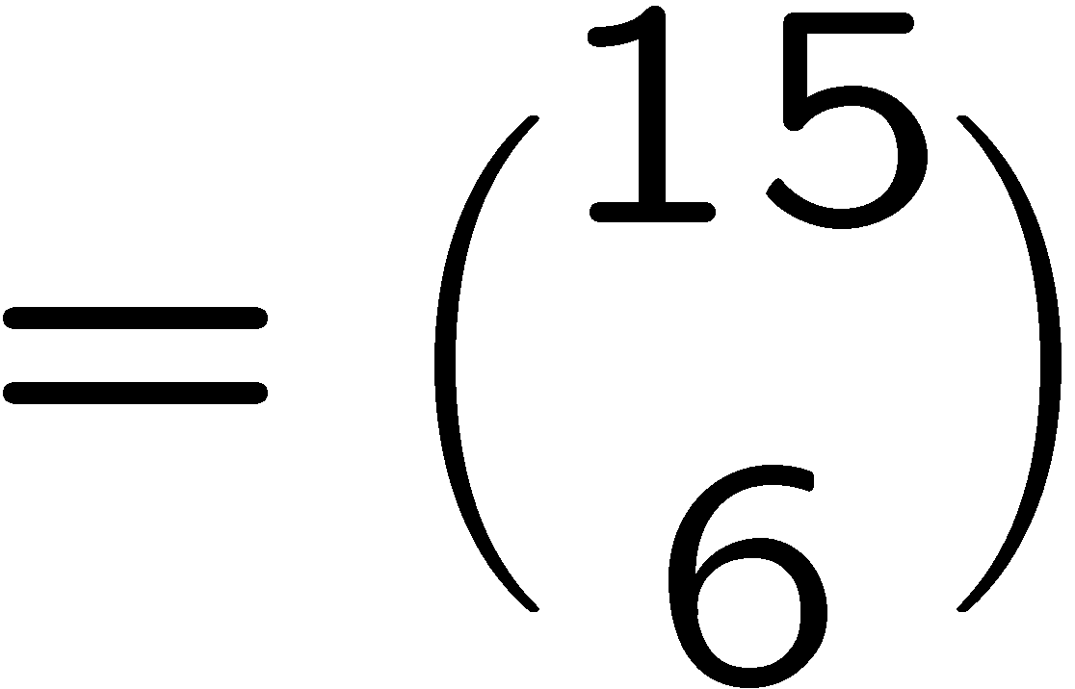
Choosing Non-Adjacent Books
A ::= all selections of 6 non-adjacent books from 20 books
B::= all 15-bit binary strings with exactly six 1’s.

Slide 20
Counting Loops
for i=1 to n do
for j=1 to i do
for k=1 to j do
printf(“hello world\n”);
How many “hello world” will this program print?
A ::= all (i,j,k) triple
B::= all strings with n-1 zeroes and 3 ones.

Slide 21
Counting Loops
for i=1 to n do
for j=1 to i do
for k=1 to j do
printf(“hello world\n”);
There are n possible values for the i,j,k.
1 2 3 4 5 … n
…
Imagine there are n-1 separators for the n values.
If i=4, j=2, k=2, then there are two zeroes in 2 and one zero in 4.

Slide 22
Counting Loops
for i=1 to n do
for j=1 to i do
for k=1 to j do
printf(“hello world\n”);
There are n possible values for the i,j,k.
1 2 3 4 5 … n
…
k
j
i
In general, the position of the first zero corresponds to the value of k.
The position of the second zero corresponds to the value of j.
The position of the third zero corresponds to the value of i.

Slide 23
Counting Non-Negative Integer Solutions
How many solutions are there to the equation x₁+x₂+x₃+x₄=10,
where x₁,x₂,x₃,x₄ are nonnegative integers?
It is just like buying 10 doughnuts from 4 types.
A ::= all non-negative integer solutions x₁+x₂+x₃+x₄=10
B::= all 13-bit binary strings with exactly three 1’s.
Think of there are 10 points to be distributed into 4 variables.
x₁ x₂ x₃ x₄
e.g. Suppose x₁=3, x₂=5, x₃=2, x₄=0,
the 3 ones are used for separations.
0 0 0 0 0 0 0 0 0 0

Slide 24
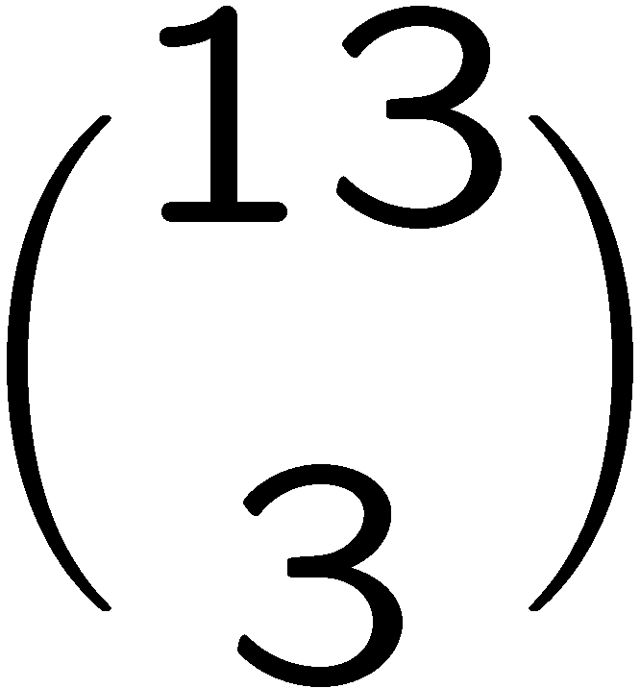
Counting Non-Negative Integer Solutions
How many solutions are there to the equation x₁+x₂+x₃+x₄=10,
where x₁,x₂,x₃,x₄ are nonnegative integers?
It is just like buying 10 doughnuts from 4 types.
A ::= all non-negative integer solutions x₁+x₂+x₃+x₄=10
B::= all 13-bit binary strings with exactly three 1’s.
It is not difficult to verify that this is a bijection,
by the same argument as in doughnut selections.
So, the are exactly integer solutions.

Slide 25
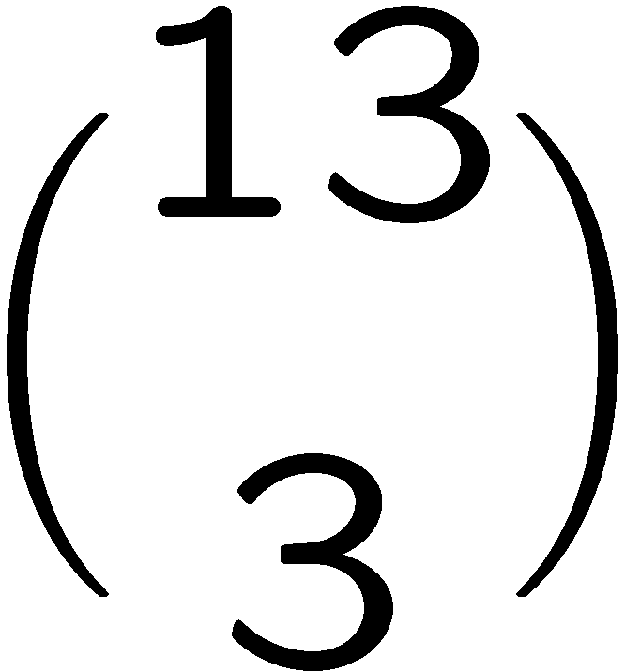
Counting Positive Integer Solutions
How many integer solutions to x₁+x₂+x₃+x₄=14 if each x_{i}>=1?
Set x_{i}=y_{i}+1. So, y₁ = x₁-1; y₂ = x₂-1; y₃ = x₃-1; y₄ = x₄-1;
Consider the equation y₁+y₂+y₃+y₄=10 where each y_{i} >=0.
There is a bijection between the solutions for y and
the solutions for x.
Therefore we can apply the previous result,
and conclude that the answer is

Slide 26
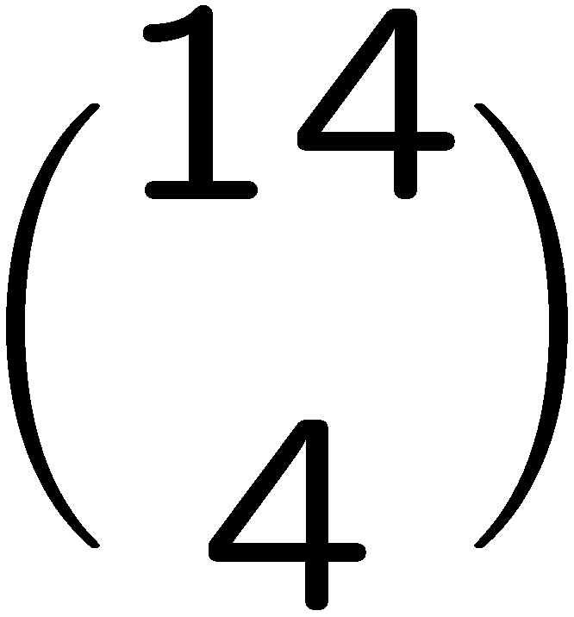
Counting Positive Integer Solutions
How many integer solutions to x₁+x₂+x₃+x₄<=10 if each x_{i}>=0?
Consider the equation y₁+y₂+y₃+y₄+y₅=10 where each y_{i}>=0.
There is a bijection between the solutions for y and
the solutions for x.
Therefore we can apply the previous result,
and conclude that the answer is
because we need 4 ones and 10 zeroes.

Slide 27
Choosing Non-Adjacent Books Revisited
A ::= all selections of 6 non-adjacent books from 20 books
B::= the set of integer solutions to x₁+x₂+x₃+x₄+x₅+x₆<=20
where x₁>=1 and x₂,x₃,x₄,x₅,x₆>=2.
Here, each x_{i} represents to pick the x_{i}th book after the previous chosen book.
1
2
3
4
5
6
7
8
9
10
11
12
13
14
15
16
17
18
19
20
e.g. this configuration corresponds to x₁=1, x₂=4, x₃=2, x₄=5, x₅=4, x₆=4.
It is not difficult to check that this is a bijection.

Slide 28
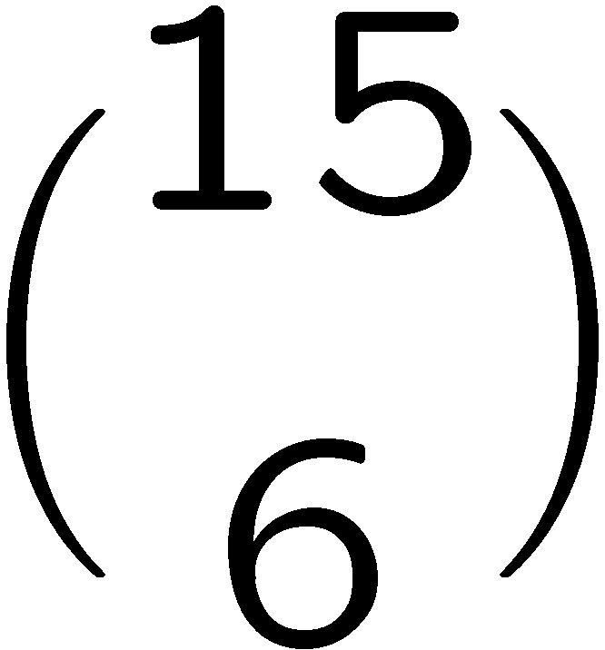

Choosing Non-Adjacent Books Revisited
A ::= all selections of 6 non-adjacent books from 20 books
B::= the set of integer solutions to x₁+x₂+x₃+x₄+x₅+x₆<=20
where x₁>=1 and x₂,x₃,x₄,x₅,x₆>=2.
Set, x₁ = y₁+1 => y₁>= 0 and for i ∈ {2..6}, x_{i} = y_{i}+2 => y_{i}>= 0, So, y₁,y₂,y₃,y₄,y₅,y₆>=0
So, we can say: |B|=|C| for
C::= the set of integer solutions to y₁+y₂+y₃+y₄+y₅+y₆<=9
where y₁,y₂,y₃,y₄,y₅,y₆>=0.
Again, we can say |C|=|D| for
D::= the set of integer solutions to x₁+x₂+x₃+x₄+x₅+x₆+x₇=9
where x₁,x₂,x₃,x₄,x₅,x₆,x₇>=0.
exactly integer solutions are
there to the equation x₁ + x₂ + x₃ + x₄= 10, where x₁,x₂,x₃,x₄ are nonnegative integers?
So, |D|=
So, the are exactly integer solutions.

Slide 29
This Lecture
Bijection rule
Division rule
More mapping

Slide 30
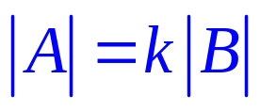
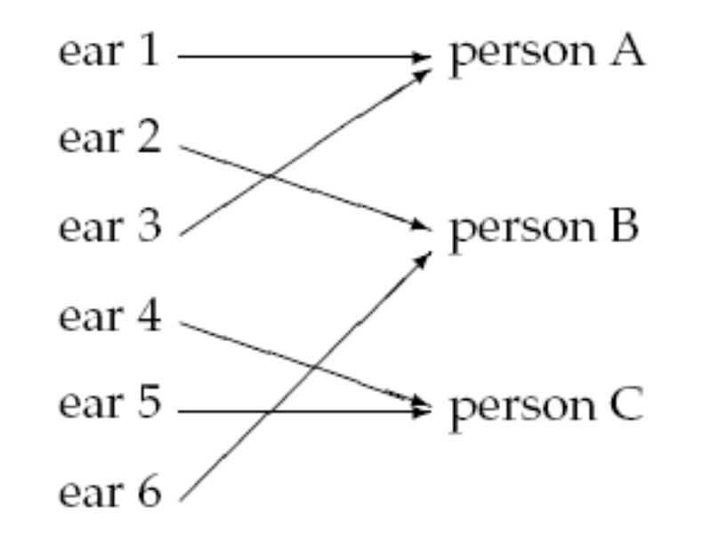
Division Rule
if function from A to B is k-to-1,
then
(generalizes the Bijection Rule)

Slide 31
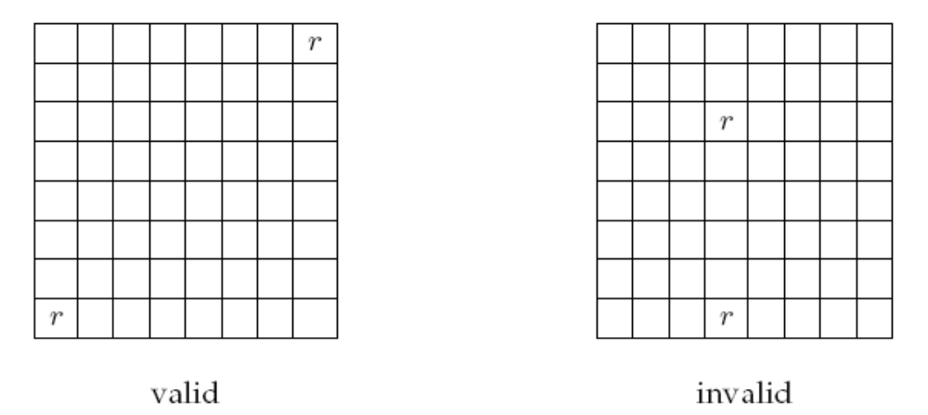
Another Chess Problem
In how many different ways can you place two identical rooks on a chessboard so that
they do not share a row or column?

Slide 32
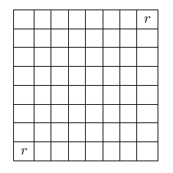
Another Chess Problem
We define a mapping between configurations
to sequences (r(1), c(1), r(2), c(2)),
where r(1) and r(2) are distinct rows,
and c(1) and c(2) are distinct columns.
A ::= all sequences (r(1),c(1),r(2),c(2)) with r(1) ≠ r(2) and c(1) ≠ c(2)
B::= all valid rook configurations
(1,1,8,8) and (8,8,1,1) maps
to the same configuration.
The mapping is a 2-to-1 mapping.

Slide 33

Another Chess Problem
A ::= all sequences (r(1),c(1),r(2),c(2)) with r(1) ≠ r(2) and c(1) ≠ c(2)
B::= all valid rook configurations
The mapping is a 2-to-1 mapping.
Using the generalized product rule to count |A|,
there are 8 choices of r(1) and c(1),
there are 7 choices of r(2) and c(2),
and so |A| = 8x8x7x7 = 3136.
Thus, total number of configurations
|B| = |A|/2 = 3136/2 = 1568.

Slide 34
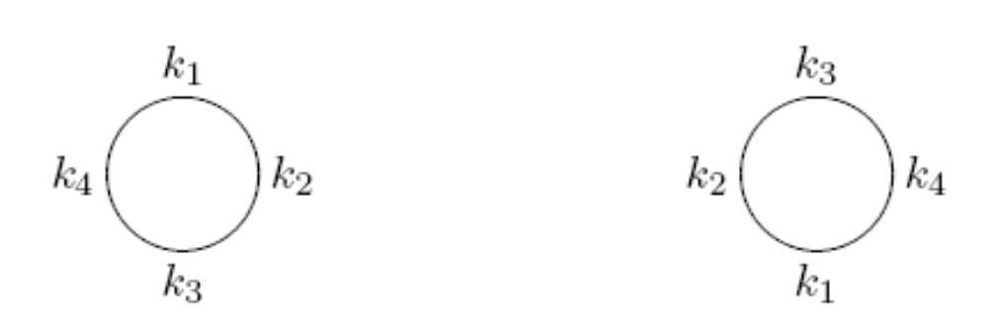
Round Table
How many ways can we seat n different people at a round table?
Two seatings are considered equivalent if one can be obtained from the other by rotation.
equivalent

Slide 35
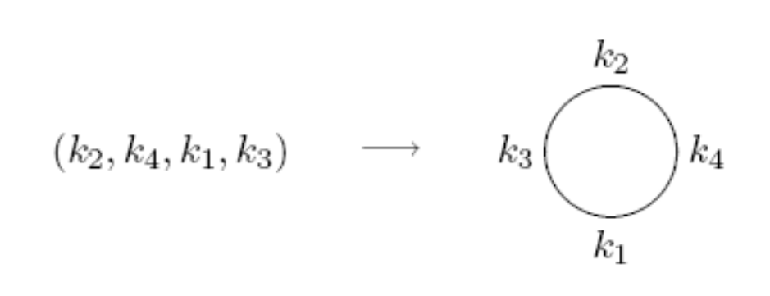
Round Table
A ::= all the permutations of the people
B::= all possible seating arrangements at the round table
Map each permutation in set A to a circular seating arrangement in set B by following the natural order in the permutation.

Slide 36
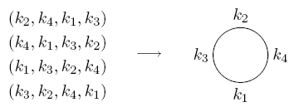

Round Table
A ::= all the permutations of the people
B::= all possible seating arrangements at the round table
This mapping is an n-to-1 mapping.
Thus, total number of seating arrangements
|B| = |A|/n = n!/n = (n-1)!

Slide 37
Counting Subsets
How many size 4 subsets of {1,2,…,13} are there?
Let A::= permutations of {1,2,…,13}
B::= size 4 subsets
map a₁ a₂ a₃ a₄ a₅… a₁₂ a₁₃ to
{a₁,a₂ ,a₃, a₄}
How many permutations are mapped to the same subset??

Slide 38

Counting Subsets
map a₁ a₂ a₃ a₄ a₅… a₁₂ a₁₃ to
{a₁,a₂ ,a₃ , a₄}
a₂ a₄ a₃ a₁ a₅ … a₁₂ a₁₃ also maps to
{a₁,a₂ ,a₃, a₄}
as does
a₂ a₄ a₃ a₁ a₁₃ a₁₂ … a₅
4!
9!
So this mapping is
4!9!-to-1

Slide 39
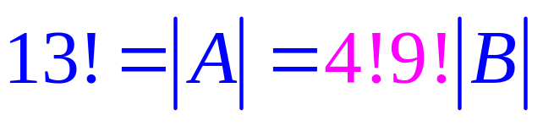
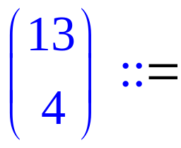
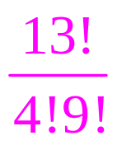
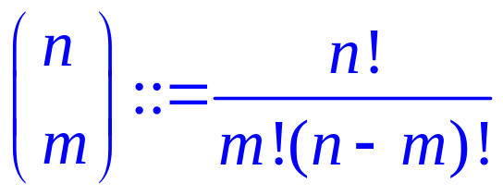
Counting Subsets
Let A::= permutations of {1,2,…,13}
B::= size 4 subsets
So number of 4 element subsets is
Number of m element subsets of an n element set is

Slide 40
MISSISSIPPI
How many ways to rearrange the letters in the word “MISSISSIPPI”?
Let A be the set of all permutations of n letters.
B be the set of all different words by rearranging “MISSISSIPPI”.
How many permutations are mapped to the same word?
4! possible ways to rearrange the S giving the same word
MISSISSIPPI
4! possible ways to rearrange the I giving the same word
2! possible ways to rearrange the P giving the same word
The mapping is 4!4!2!-to-1, and so there are 13!/4!4!2! different words.

Slide 41
Example: 20 Mile Walk
I’m planning a 20-mile walk, which should include 5 northward miles, 5 eastward miles, 5 southward miles, and 5 westward miles.
How many different walks are possible?
There is a bijection between such walks and sequences with 5 N’s, 5 E’s, 5 S’s, and 5 W’s.
The number of such sequences is equal to the number of rearrangements:
20!
5!5!5!5!

Slide 42
This Lecture
Bijection rule
Division rule
More mapping

Slide 43
Parenthesis
How many valid ways to add n pairs of parentheses?
E.g. There are 5 valid ways to add 3 pairs of parentheses.
((())) (()()) (())() ()(()) ()()()
Let r_{n} be the number of ways to add n pairs of parentheses.
A pairing is valid if and only if there are at least as many
open parentheses than close parentheses from the left.

Slide 44
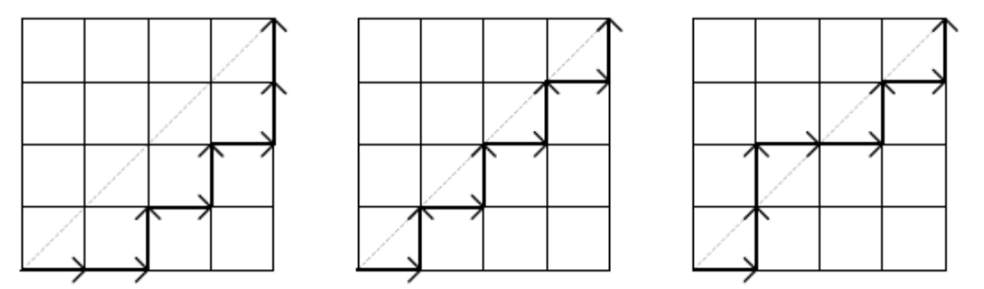
Monotone Path
A monotone path from (0,0) to (n,n) is a path consisting of “right" moves (x-coordinate increase by 1) and “up" moves (y-coordinate increase by 1), starting at (0,0) and ending at (n,n).
We say such a path “lower-right" monotone path if all of the points (x_{i},y_{i}) on the path has x_{i} >= y_{i}.
lower-right monotone
NOT lower-right monotone

Slide 45
Mountain Ranges
How many “mountain ranges” can you form with n upstrokes
and n downstrokes that all stay above the original line?
/\
/\ /\ /\/\ / \
/\/\/\, /\/ \, / \/\, / \, / \
We do not know how to solve these three problems yet, but
we can show that all these three problems have the same answer,
by showing that there are bijections between these sets.

Slide 46
Parenthesis and Monotone Paths
A pairing is valid if and only if there are at least as many
open parentheses than close parentheses from the left.
A monotone path is “lower-right” if and only if there are at
least as many right moves than up moves from the starting point.
(()()()) ()()()()
So there is a bijection between these two sets by each open
parenthesis with a right move and a close parenthesis by an up move.

Slide 47
Monotone Paths and Mountain Ranges
By “rotating” the images, we see that a path not crossing the diagonal
is just the same as a mountain not crossing the horizontal line.
So there is a bijection between them by mapping “right” to “up” and “up” to “down”

Slide 48
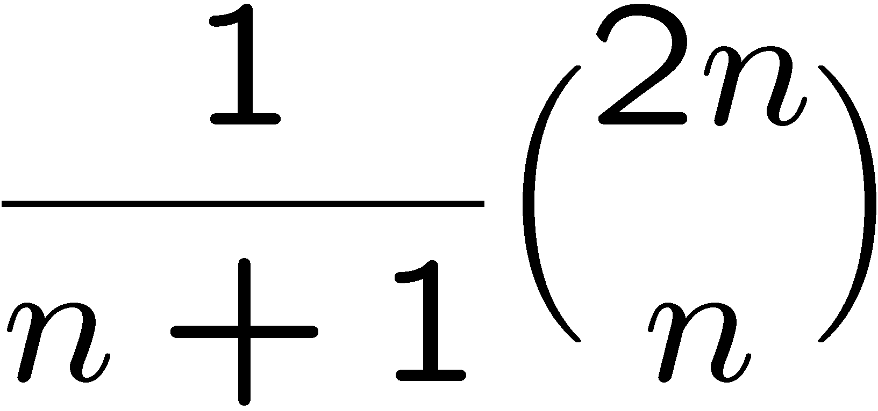
Parenthesis, Monotone Paths and Mountain Ranges
Now we know that these three sets are of equal size,
although we don’t know the size.
It turns out that the answer is exactly
This is called the nth Catalan number,
and has applications in many other places as well.
We will not compute it in the lecture. This is FYI for now.

Slide 49
Quick Summary
Counting by mapping is a very useful technique.
It is also a powerful technique to solve more complicated problems.
The basic examples usually map a set into a properly defined binary strings.
Then we see how to generalize this approach by considering k-to-1 functions.
Finally we see the mapping between more complicated sets.

